Slide 1
BRITISH AIRWAYS CUSTOMER BOOKING PREDICTIVE MODELLING REPORT
BY ALHERI YUSUF

Slide 2
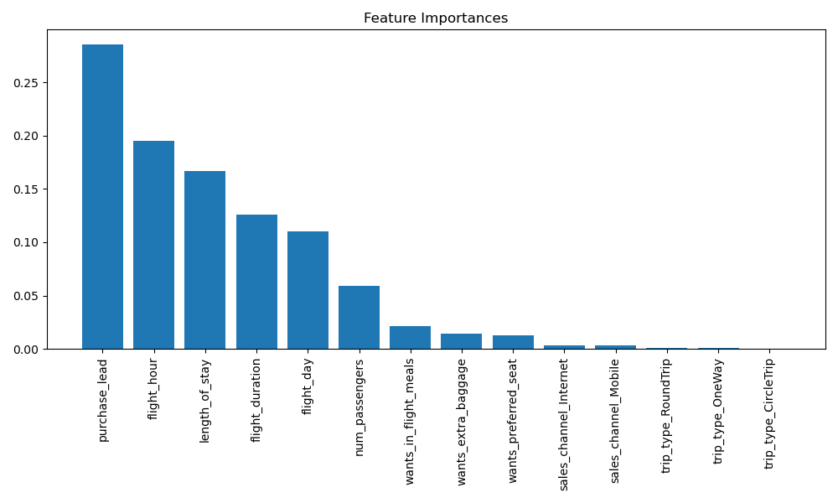
BRITISH AIRWAYS CUSTOMER BOOKING PREDICTIVE MODELLING REPORT
NOTE: the dataset was found to be imbalanced with high count of uncompleted book than completed book. SMOTE was used to balance the dataset.
Precision
86%
Recall
95%
The model was found to have 86% chance to avoid predicting incomplete booking as complete.
The model was found to have 95% chance to find all complete booking.
The model was found to have 83% chance of accurately predicting complete and incomplete bookings.
Accuracy
83%
Top Features That Drive Successful Flight Booking

